Slide 1
Hi all have a go at exercise 3A page 73 first
Then have a look at the next pages

Slide 2
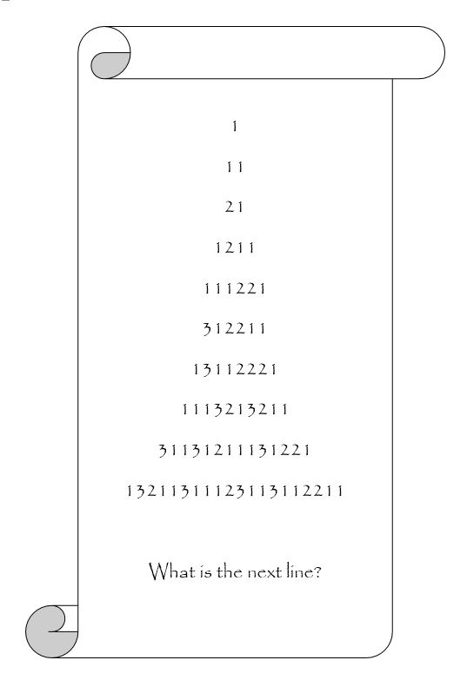
Introduction to sequences
An ordered list of numbers, separated by commas, is called a progression or sequence. For example −3,5,13,21 and 1,10,100,1000 are two interesting mathematical progressions. If the sequence ends, it is known as a finite sequence. Otherwise it is said to be infinite. You might notice that in both examples there is a pattern in the way the progressions are formed. In the first progression, each term, other than the first, is eight more than the previous term in the list. In the second progression, each term, apart from the first, is ten times more than the previous term. When a pattern is detectable in a progression, a generating rule can often be established that allows us to determine any term in the sequence.
Sequences can have strange generating rules like this one provided by the mathematician John Conway. It begins 1,11,21,1211,111221,… and so on. It starts with the number 1, and the next term is created by observing that the first term is really “one 1”. The third term is created by observing that the second term is really “two 1s”. The fourth term likewise is generated as “one 2, and one 1”. The process of generation continues indefinitely.

Slide 3
There are some sequences that appear to have no pattern at all, but nevertheless have a certain logical way of building. For example, the sequence 3,1,4,1,5,9,… separating the digits of pi - π exhibits no discernable pattern and continues to do so indefinitely.
There are strange sequences such as 7,22,11,34,17,52,26,13,40,20,10,5,16,8,4,2,1,4,2,1,4,2,… which begin with any positive integer (here, 7 was chosen) and then, depending on the parity of the starting term, one of two rules are used to generate the next term. If the term is odd, triple it and add 1. If it’s even, halve it. In this way the sequence always ends with the three numbers 4, 2 and 1, no matter what the starting number.

Slide 4
SEQUENCES A sequence is a set of numbers in order, determined by some defining rule. This may be explicit (the rule is stated) or implicit (the rule may be implied from a listing of the ordered terms).
The first term of a sequence is denoted by T₁
The second term of a sequence is denoted by T₂
The third term of a sequence is denoted by T₃
The nth term of a sequence is denoted by T_{n}
Ex In the sequence 5, 9, 13, 17, . . . T₁ = 5, T₄ = 17 T_{n} = 4n + 1 (Do you remember how to find rules??)
The first term is 5 the fourth term is 17 the nth term is found by multiplying n by 4, then adding 1
e.g.
IMPLICIT EXPLICIT
 | General term | Recursive
1, 2, 3, 4, . . . | T_{n} = n | T_{n+1} = T_{n} + 1; T₁ = 1
7, 10, 13, 16, . . . | T_{n} = 3n + 4 | T_{n+1} = T_{n} + 3; T₁ = 7
1, 2, 4, 8, 16, . . | T_{n} =2^{n-1} | T_{n+1} = T_{n} × 2; T₁ = 1
1, 1, 2, 5, 8, 13, . . |  | T_{n+1} = T_{n} + T_{n-1}; T₁ = 1, T₂ = 1
144, 108, 72, 48, . . | Tn =216 × (⅔)^{n} | T_{n+1} = T_{n} ×⅔ ; T₁ = 144
1, 4, 9, 16, 25, . . . | T_{n} =n² | T_{n+1} = T_{n} + 2n + 1; T₁ = 1
60, 30, 20, 15, 12, . . . | T_{n} = | T_{n+1} = T_{n} × ; T₁ = 60
5, 13, 29, 61, 125, . . | T_{n} =2^{n+2} - 3 | T_{n+1} = 2 ×T_{n} + 3; T₁ = 5
Now try Exercise 3B page 75

Slide 5
RECURSIVE DEFINITION
A recursive definition of a sequence states how to obtain the next term of a sequence given the previous term (or terms). You also need a marker, usually the first term (or terms).
Ex 1 T_{n+1} = T_{n} + 3, T₁ = 4 Tn+1 is the very next term after Tn . The first statement (T_{n+1} = T_{n} + 3) thus tells us that every term of the sequence is 3 more than the previous term. The second statement (T₁ = 4) tells us that the first term of the sequence is 4.
Hence the sequence is 4, 7, 10, 13, 16, . . Ex 2 T_{n} = 2T_{n-1} + 3, T₁ = 2 T_{n} is the very next term after T_{n-1} . The first statement (T_{n} = 2T_{n-1} + 3) thus tells us that every term of the sequence is obtained by multiplying the previous term by 2 and then adding 3. The second statement (T₁ = 2) tells us that the first term of the sequence is 2.
Hence the sequence is 2, 7, 17, 37, 77, . . . Ex 3 T_{n+1} = T_{n} + T_{n-1}, T₁ = 1, T₂ = 1 T_{n} and T_{n-1} are the two previous terms to T_{n+1}. The first statement (T_{n+1} = T_{n} + T_{n-1}) thus tells us that every term of the sequence is obtained by adding the two previous terms. The second and third statements (T₁ = 1, T₂ = 1) tell us that the first term of the sequence is 1 and the second term is also 1.
Hence the sequence is 1, 1, 2, 3, 5, 8, 13, 21, 34, , . . . (i.e. the Fibonacci Sequence)

Slide 6
Ex 4 If T_{n+1} = 1.5T_{n}, T₄ = 216, find the first 3 terms of the sequence Solution: The first statement (T_{n+1} = 1.5T_{n}) tells us that any term may be found by multiplying the previous term by 1.5. Hence the term prior to a term may be found by dividing by 1.5 Hence T₃ = T₄ ÷ 1.5 = 216 ÷ 1.5 = 144 Hence T₂ = T₃ ÷ 1.5 = 144 ÷ 1.5 = 96 Hence T₁ = T₂ ÷ 1.5 = 96 ÷ 1.5 = 64 Thus the first three terms are 64, 96, 144
Ex 5 The recursive formula for the sequence 4, 11, 25, 53, 109, . . is T_{n} = aT_{n-1} + b Find a and b Solution: We know that T₁ = 4 and T₂ = 11 Hence 11 = 4a + b (equation 1) We know that T₂ = 11 and T₃ = 25 Hence 25 = 11a + b (equation 2) By subtracting equation 1 from equation 2 (we have two simultaneous equations) we have 14 = 7a Hence a = 2 Substitute in equation 1 11 = 8 + b Hence b = 3

Slide 7
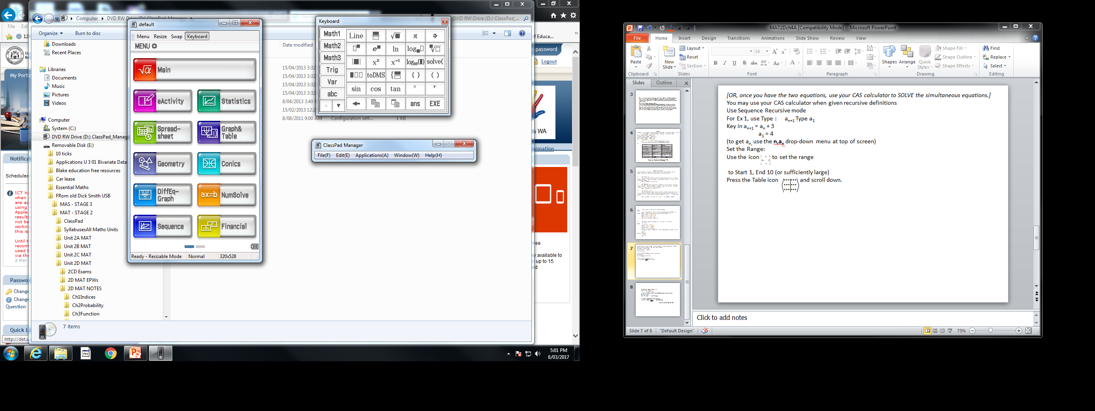
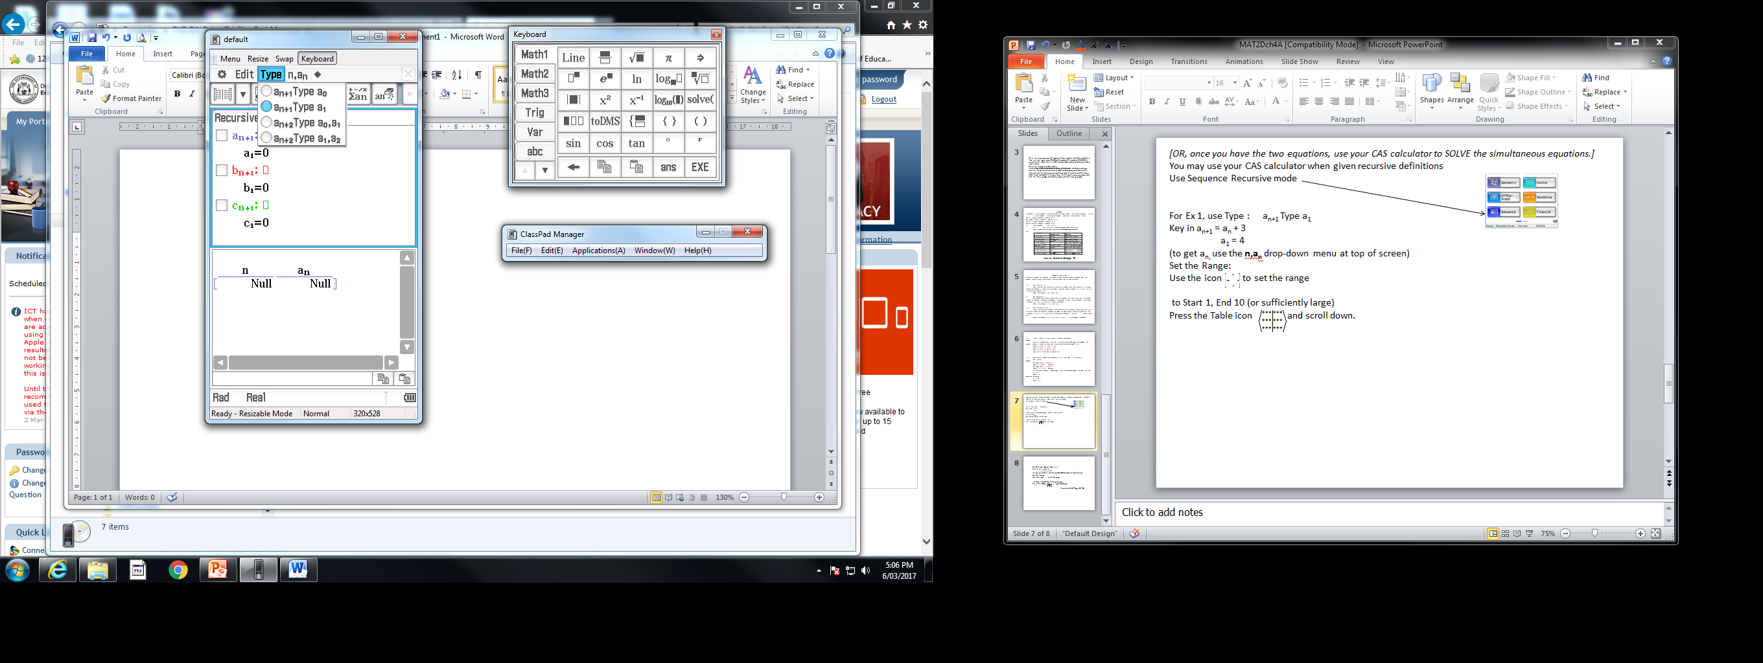
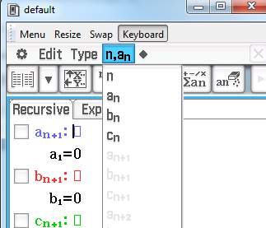
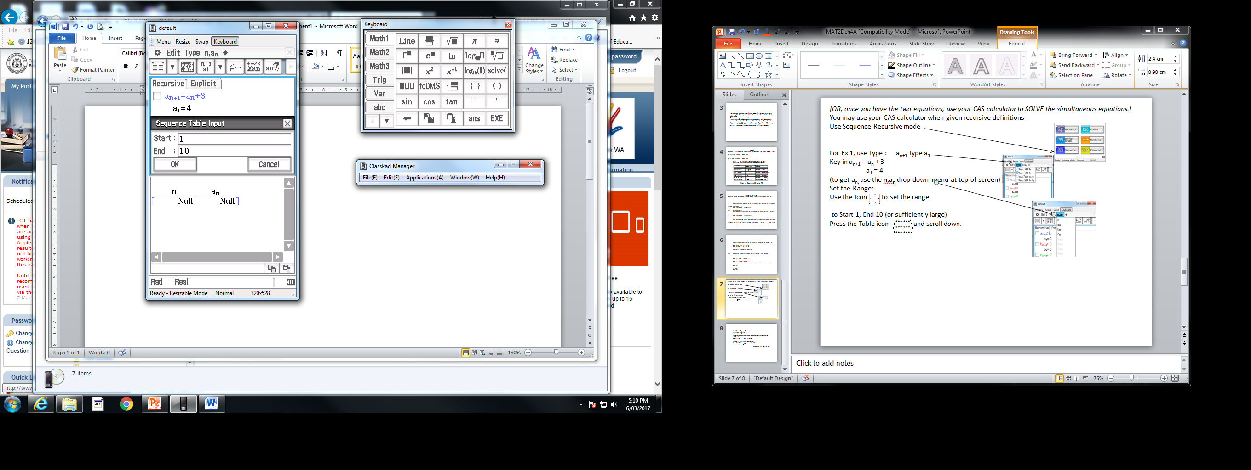
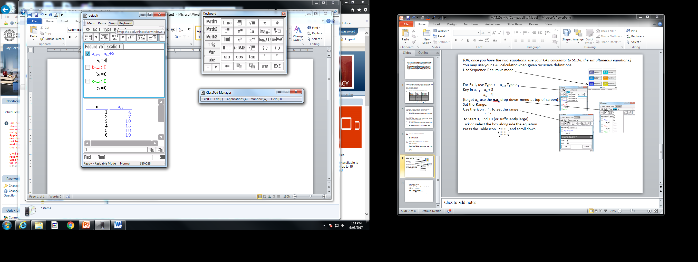
[OR, once you have the two equations, use your CAS calculator to SOLVE the simultaneous equations.]
You may use your CAS calculator when given recursive definitions
Use Sequence Recursive mode
For Ex 1, use Type : a_{n+1} Type a₁ Key in a_{n+1} = a_{n} + 3
a₁ = 4
(to get a_{n,} use the n,a_{n} drop-down menu at top of screen) Set the Range: Use the icon to set the range
to Start 1, End 10 (or sufficiently large) Tick or select the box alongside the equation
Press the Table icon and scroll down.

Slide 8
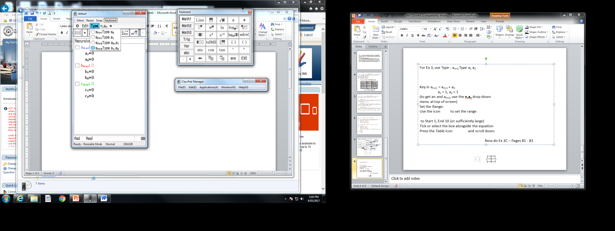
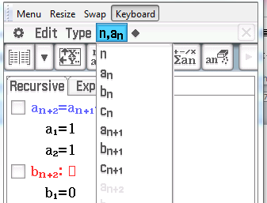
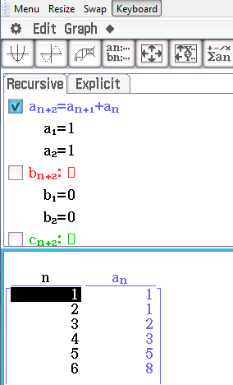
For Ex 3, use Type : a_{n+2} Type a₁ a₂
Key in a_{n+2} = a_{n+1} + a_{n}
a₁ = 1, a₂ = 1
(to get an and a_{n+1}, use the n,a_{n} drop-down
menu at top of screen) Set the Range: Use the icon to set the range
to Start 1, End 10 (or sufficiently large) Tick or select the box alongside the equation
Press the Table icon and scroll down.
Now do Ex 3C – Pages 81 - 83

